Slide 1

EECS221 Presentation
Hardware Acceleration
with Runtime Reconfiguration
Name: Zeqiang Zheng
ID: 001088867

Slide 2

CONTENTS
Background
Methodology
1
2
Progress
Further Improvement
3
4

Slide 3

01
Background

Slide 4
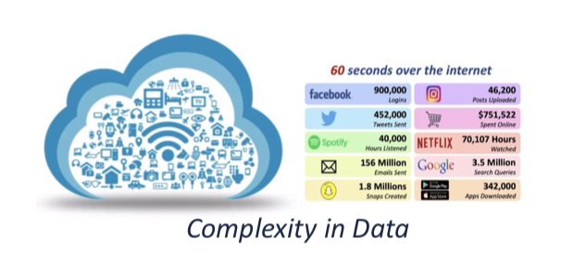
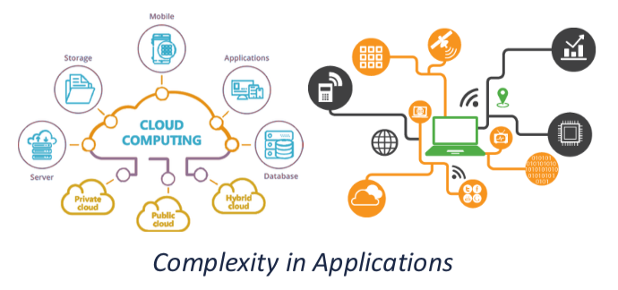
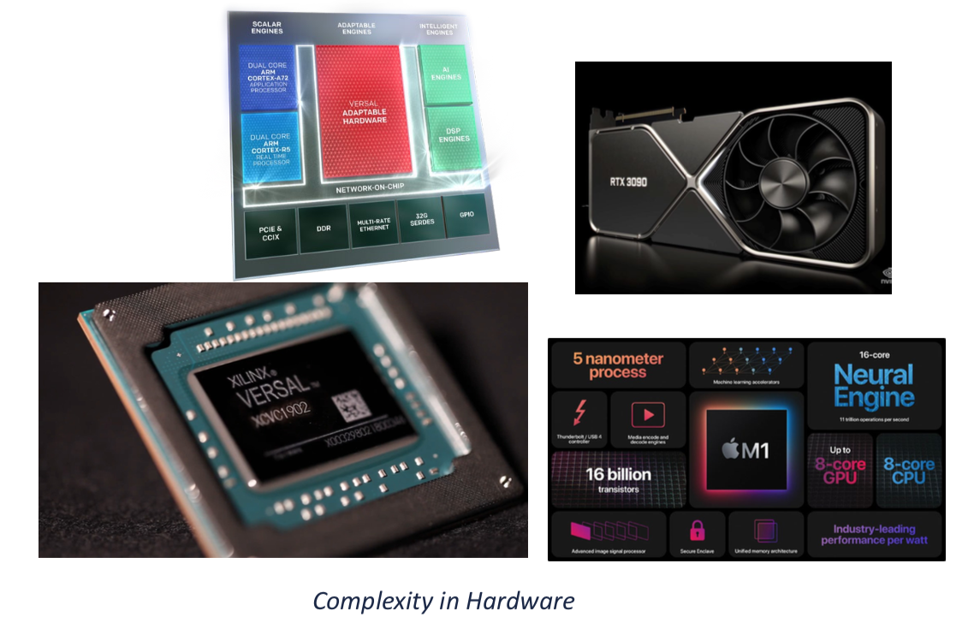
Background
Emerging computing applications are becoming more and more complicated
Lower latency and higher energy efficiency provided by FPGA acceleration
Previous attempts have focused on a particular application or domain of applications[1]
* The 3 figures are from the slides*
[1]A. Dhar, M. Yu, W. Zuo, X. Wang, N. S. Kim and D. Chen, "Leveraging Dynamic Partial Reconfiguration with Scalable ILP Based Task Scheduling," 2020 33rd International Conference on VLSI Design and 2020 19th International Conference on Embedded Systems (VLSID), 2020, pp. 201-206, doi: 10.1109/VLSID49098.2020.00052.

Slide 5
Preliminery Thought
Universal Computing Scheme
1
2
Runtime Dynamic Reconfiguration
Scheduling Strategy
3
4
Partial Reconfiguration

Slide 6
02
Methodology

Slide 7
Overview: A General Flow
Algorithm Implementation
A
Simple Vector Addition in this Project
Implemented by VItis HLS
At least 2 versions
Overlays Preparation
B
System-on-chip design flows with vector addition IP using Vivado
Runtime Decision Branch
C
A decision is needed to select overlay before reconfiguration.
We use PYNQ library & Jupyter Notebook Pytho environment.
Runtime Reconfiguration
D
Test the performance of our computing scheme with PYNQ library.

Slide 8
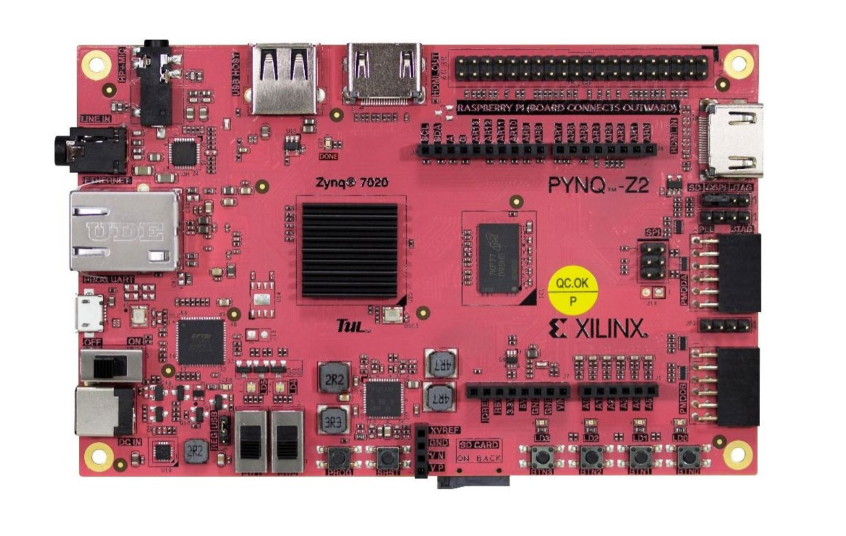

Slide 9
Interface of tools
VItis HLS
PYNQ
Vector Addition IP
Vivado
Overlay of SoC

Slide 10
03
Current Progress

Slide 11
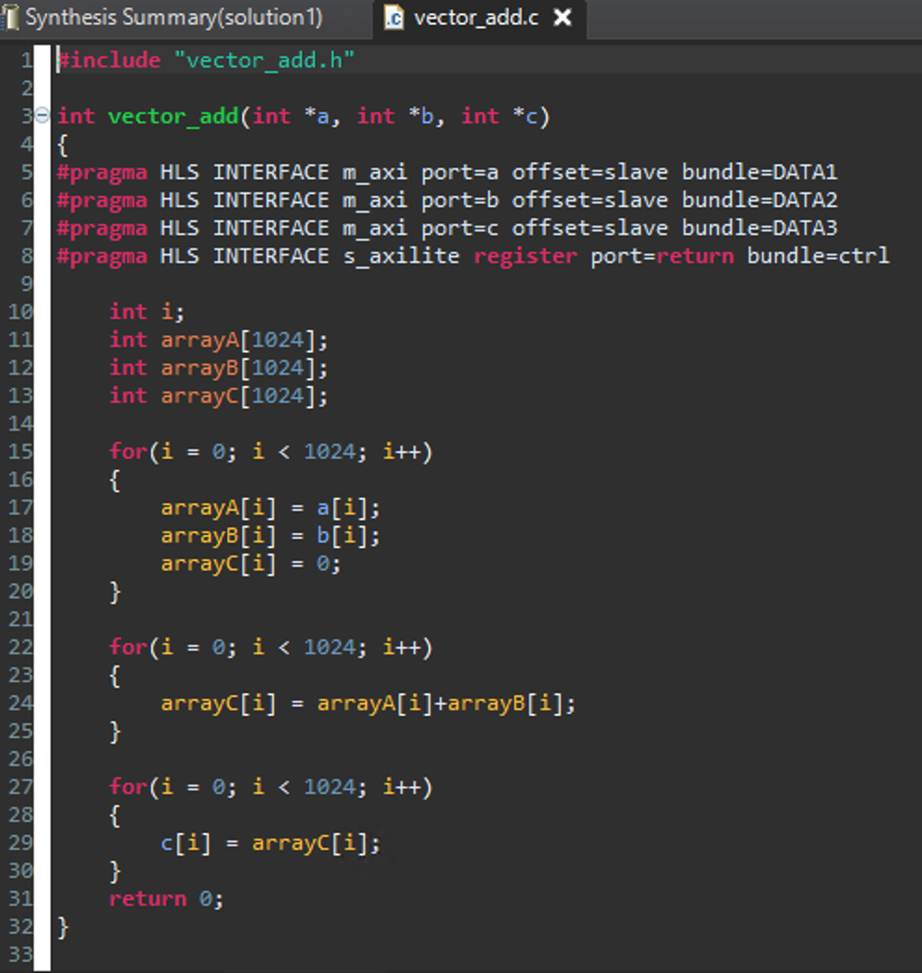
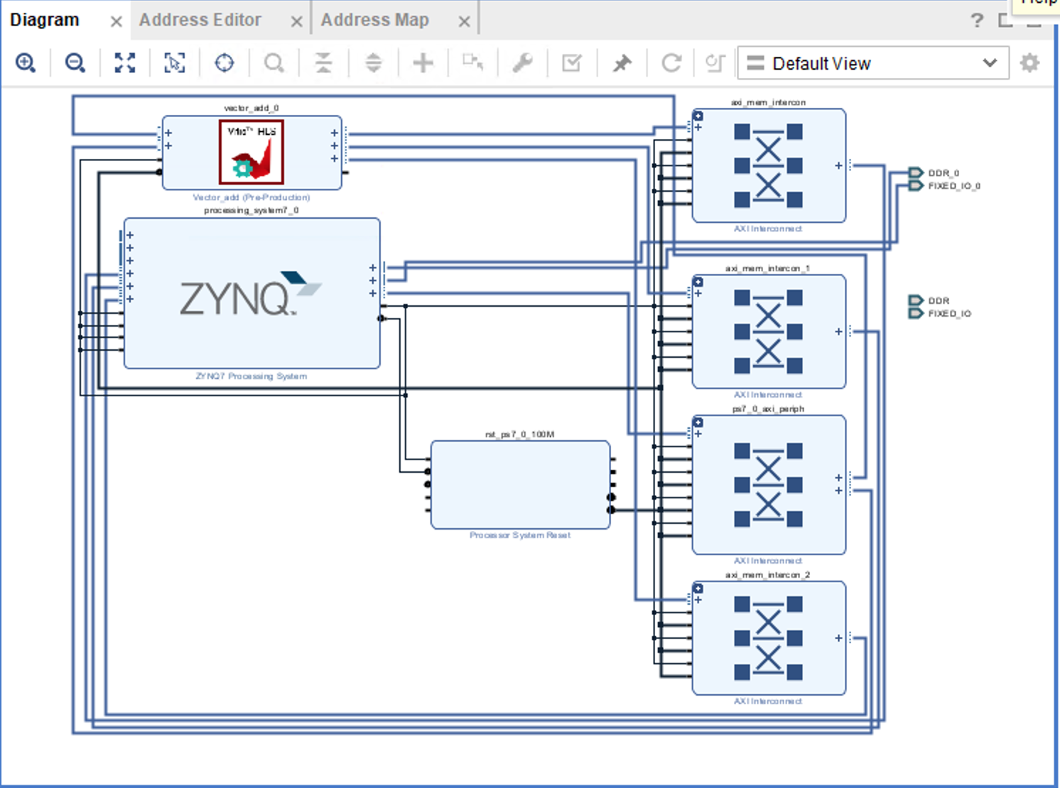
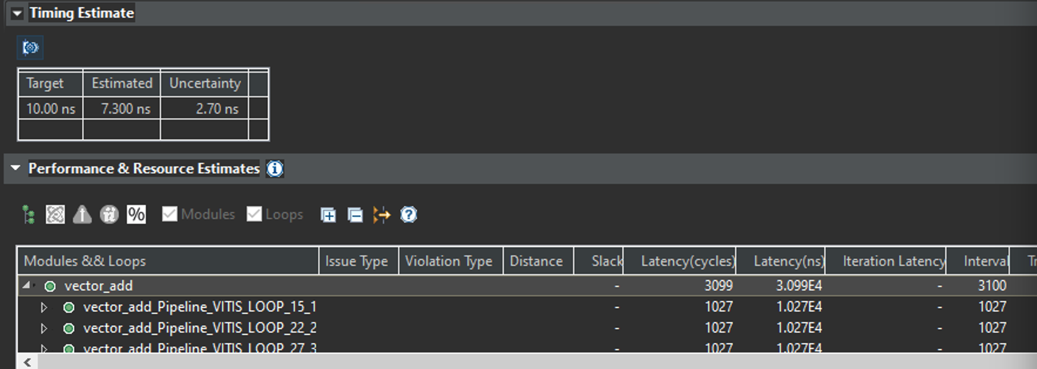

Slide 12
Further
Improvement
04

Slide 13
Directions of Further Improvement
More complicated application
More candidate FPGA overlays
Partial Reconfiguration
…………

Slide 14
Open-source!
Github:
https://github.com/Zheng-Zeqiang/Vivado_Vector_Add
UCI Gmail: zeqiangz@uci.edu
You are very welcomed to make contribution to this project
or discuss your idea with me!

Slide 15
Q&A
Thank You!

